Slide 1
Transboundary Conservation Areas
Lesson 5
Initiating transboundary conservation: Design the process I: Engage the right people and define the geographic extent
Notes:
Photo Credit: Maloti-Drakensberg Park World Heritage Site (Lesotho and South Africa) ©Maja Vasilijević
*Note that all of the photos in this presentation are of Maloti-Drakensberg Park World Heritage Site shared by Lesotho and South Africa. While the uKhahlamba Drakensberg Park in South Africa was designated as a World Heritage Site in 2000, the property was extended in 2013 to include the Sehlabathebe National Park to become a transboundary World Heritage Site.
Context and purpose of Lesson 5
This lesson seeks to introduce the second stage of the transboundary conservation process: Design the process. The purpose is to:
Introduce learners to the concepts of engaging the public, generating political support, and defining the geographic extent of the transboundary conservation initiative
Help develop understanding of how to actively and effectively engage relevant stakeholders, mobilize communities, and identify leadership
Discuss and analyze the different tasks required to define the geographic extent
Practice identifying key stakeholders and considering factors in determining geographic extent.
Supplemental Reading
IUCN WCPA Best Practice Guidelines Transboundary Conservation: A systematic and integrated approach (Pgs. 46-47, 62–64)

Slide 2
Factors of Success
Assess the enabling environment to pursue transboundary conservation
Define the transboundary context and relationships affecting the achievement of the conservation targets and the resulting geographic extent
Identify and involve stakeholders, obtain support of decision makers and ensure political will and buy-in
Agree on common values and joint vision
Determine common transboundary management objectives and develop cooperative agreements
Notes:
Photo Credit: Maloti-Drakensberg Park World Heritage Site (Lesotho and South Africa) ©Maja Vasilijević
Factors of success
Recall the five factors of success in the process of initiating transboundary conservation:
1. Assess the enabling environment to pursue transboundary conservation
2. Define the transboundary context and relationships affecting the achievement of the conservation targets and the resulting geographic extent
3. Identify and involve stakeholders, obtain support of decision makers and ensure political will and buy-in
4. Agree on common values and joint vision
5. Determine common transboundary management objectives and develop cooperative agreements
Lesson 5 focuses on learning and practicing skills needed for factors 2 and 3. It includes an exercise on defining the transboundary context and identifying and involving stakeholders.

Slide 3
Lesson Overview & Goals
Initiating Transboundary Conservation:
Design the Process I
Determining leadership
Involving people and generating support
Defining the geographic extent
Notes:
Photo Credit: Maloti-Drakensberg Park World Heritage Site (Lesotho and South Africa) ©Maja Vasilijević
Content overview
This Lesson will address:
Determining leadership, including leadership types and functions
Key considerations and approaches in involving people and generating support
Concepts and processes in defining the geographic extent of Transboundary Conservation Areas (TBCAs).

Slide 4
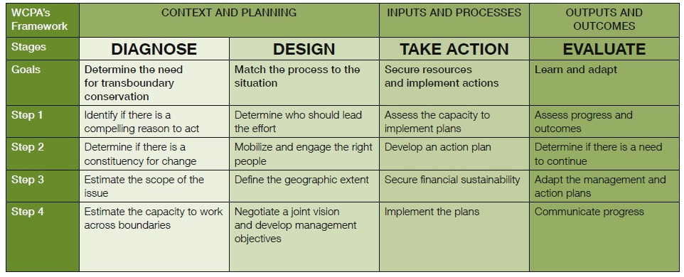
Design: Match the Process to the Situation
Notes:
Photo Credit: Maloti-Drakensberg Park World Heritage Site (Lesotho and South Africa) ©Maja Vasilijević
Design: Match the process to the situation
Refer to the transboundary conservation process introduced in Lesson 1.
Recall that the process involves four stages:
Diagnose
Design
Take Action
Evaluate
Lesson 3 addressed the first stage: Diagnose
This Lesson addresses the second stage: Design, which includes the following steps:
Determine who should lead the effort
Mobilize and engage the right people
Define the geographic extent
Negotiate a joint vision and develop management objectives
This Lesson will focus on the first three steps:
Determine who should lead the effort
Mobilize and engage the right people
Define the geographic extent
The remaining topic “Negotiate a joint vision and develop management objectives” will be dealt with in Lesson 7.
Again, it is important to remember that these steps are iterative – they do not necessarily happen in this order, and there may be a need to return to and review different steps in the process.

Slide 5
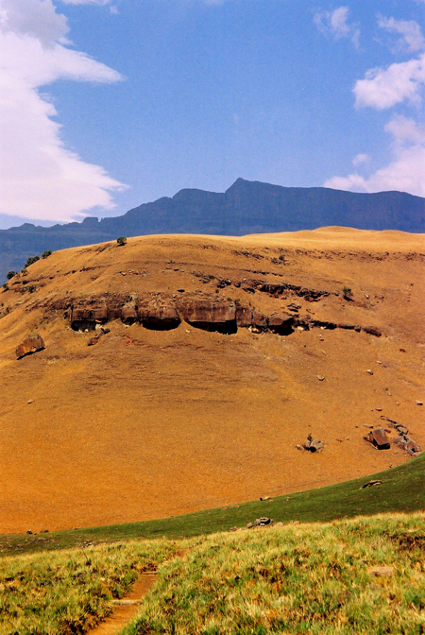
Determining Leadership
Leadership Functions
Mobilization of people
Willingness to share and devolve power
Synthesizing ideas
Assembling resources
Forging alliances with others
Inviting people to take ownership of a shared vision
Overcoming differences
Sustaining relationships
Notes:
Photo Credit: Maloti-Drakensberg Park World Heritage Site (Lesotho and South Africa) ©Maja Vasilijević
Determining leadership
Leadership is a key element of successful transboundary conservation governance. Key leadership functions include:
Mobilization of people. Leadership is needed to catalyse action in others to build constituencies for change. (Note that a ‘constituency for change’, as defined in Glossary, indicates a critical mass of people who are aware of a common challenge and ready to work together in response)
Willingness to share and devolve power. Leaders must be willing and able to work across governance sectors and levels, and delegate power to appropriate actors as necessary.
Synthesizing ideas. Leaders need to be able to bring together and harmonize different ideas, perspectives and viewpoints.
Assembling resources. Leadership is needed to bring together human, technical and financial resources and capacities necessary for transboundary conservation.
Forging alliances with others. Leadership is needed to bring together people holding diverse interests, viewpoints and mandates to work together towards one goal.
Inviting people to take ownership of a shared vision. Visionary leaders play a key role in transboundary conservation, but effective cooperation is only possible when constituents themselves develop and take ownership over that vision. Strong leaders can invite people to take ownership.
Overcoming differences. Transboundary conservation involves many different actors with different backgrounds, interests and roles. Resolving and preventing conflict is a key leadership function.
Sustaining relationships. Transboundary conservation is ultimately about relationships. Leaders need to recognize, build and sustain these relationships to enable cooperation over time.

Slide 6
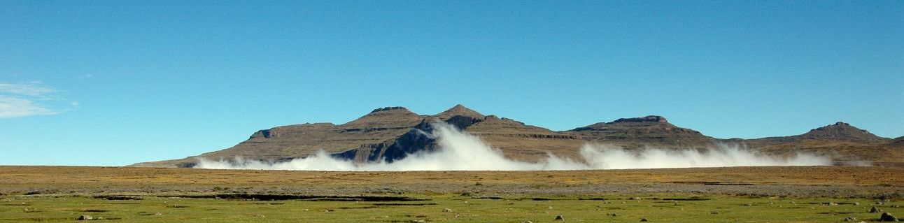
Determining Leadership
Leaders must be effective in working across borders and working with a diverse range of interests and important stakeholders
Pioneer
Thought Leader
Facilitator
Sponsor
Networker
Steward
Notes:
Photo Credit: Drakensberg / Wikimedia Commons (public domain)
Determining leadership
Leader(s) must be effective in working across boundaries with a diverse range of interests and diverse important stakeholders. TBCAs may need different types of leaders to catalyse, enable and sustain action.
Some example types of leaders are:
Pioneer: catalyze action and recruit others
Sponsor: establish credibility, stability, and legitimacy
Thought Leader: provides expertise and credibility
Networker: engage participants across jurisdictions, sectors and interests
Facilitator: bridges differences and builds agreements
Steward: coordinates activities and ensures results
TBCAs may require multiple different types of leaders at different stages in the process.
Pioneers and Sponsors may be useful in getting started
Thought Leaders and Networkers can help build momentum and mobilize resources and capacity
Stewards and Facilitators can help cope with problems that arise as transboundary conservation initiatives move forward
A single person may play multiple leadership functions, but often multiple leaders are needed in different positions on all sides of the border and working with different constituencies and levels of governance.

Slide 7
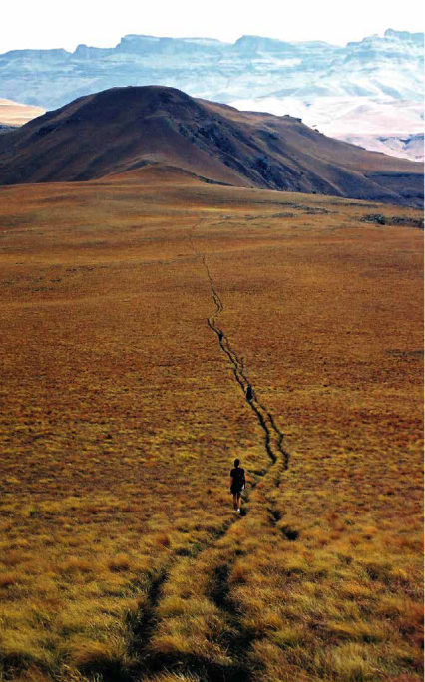
Mobilizing and Engaging People
Understanding local issues
Economic
Political
Social and Cultural
Historical
Environmental & resource management
Identifying relevant transboundary stakeholders
Local communities
Relevant management agencies
Governments
Regional organizations
Private sector
NGOs
Donors
Notes:
Photo Credit: Maloti-Drakensberg Park World Heritage Site (Lesotho and South Africa) ©Maja Vasilijević
Mobilizing and engaging people
Involving people and developing support is an essential step in designing transboundary conservation process.
To be effective, transboundary conservation initiatives must engage the right people and build a constituency for change. (Note that a ‘constituency for change’, as defined in Glossary, indicates a critical mass of people who are aware of a common challenge and ready to work together in response)
As a first step, it is important to understand local issues. This will provide key information for identifying stakeholders. Key issues include:
Economic
Political
Social and Cultural
Historical
Environmental and Resource Management
These issues should come out of the assessments in Stage 1, Diagnose the Situation, described in Lesson 3
Understanding local issues will inform the identification of relevant transboundary stakeholders. These may include:
Local communities
Relevant management agencies
Governments
Regional organizations
Private sector
NGOs
Donors

Slide 8
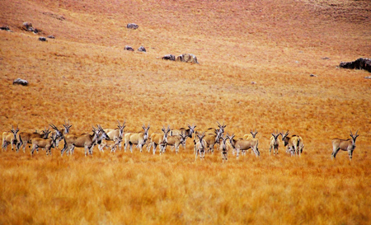
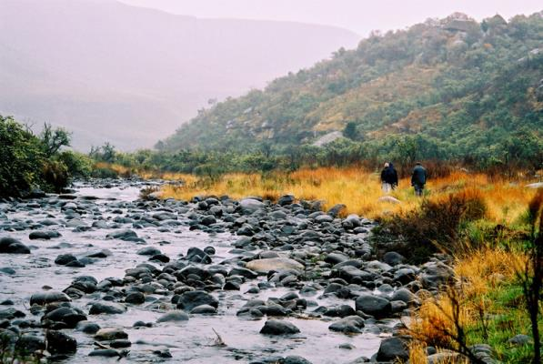
Mobilizing and Engaging People
Identify and agree on a compelling reason to act
Organize and distribute work to relevant and effective parties
Facilitate dialogues between parties
Build an inclusive constituency for change
Notes:
Photo Credit: Maloti-Drakensberg Park World Heritage Site (Lesotho and South Africa) ©Maja Vasilijević (left) and (right)
Mobilizing and engaging people
Mobilizing and engaging people is an ongoing process. It can take many forms, but often involves the following tasks:
Identify and agree upon a compelling reason to encourage collaboration and cooperation. This compelling reason to act was discussed in Lesson 3. (Note that ‘compelling reason to act’, as defined in Glossary, indicates a reason or motive that is convincing enough to undertake transboundary conservation and engage in transboundary cooperation)
Organize and distribute work to relevant and effective parties. Being as inclusive as possible helps ensure that people affected by the initiative feel ownership of the process and outcome.
Facilitate dialogues between parties. Continued dialogue and communication helps involve multiple interest groups and grow a common vision while addressing potential conflict.
Build an inclusive constituency for change in transboundary areas. (Note that a ‘constituency for change’, as defined in Glossary, indicates a critical mass of people who are aware of a common challenge and ready to work together in response) In some cases, a constituency may already exist. However, it may exist only to a limited extent, or not at all. Some transboundary conservation initiatives need to build a constituency from a small group of interested people or from scratch.

Slide 9

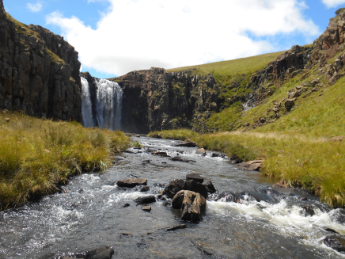
Defining the Geographic Extent
Two Distinct but Close Processes
Delineating the boundaries – identification of extent
Mapping the delineated area – detailed assessment
Both processes are iterative, consultative, flexible, adaptive and may be time consuming
Notes:
Photo Credit: Maloti-Drakensberg Park World Heritage Site (Lesotho and South Africa) ©Peace Parks Foundation (top) and (bottom)
Defining the geographic extent
Step 3 of the Design phase is defining the geographic extent. It involves two distinct but close processes:
Delineating the boundaries of the area to be included in the transboundary conservation initiative. This process should be consultative, flexible, adaptive and iterative. The proposed area may change depending on needs and interests of stakeholders, environmental information and considerations of governance and management feasibility.
Mapping the delineated area involves a more detailed assessment of the social, economic, legal, institutional, environmental, geological and other conditions within the proposed area.
The two processes are iterative, consultative, flexible, adaptive and may be time consuming. Mapping the delineated area often requires a revision of the initial boundaries for the transboundary conservation initiative.

Slide 10
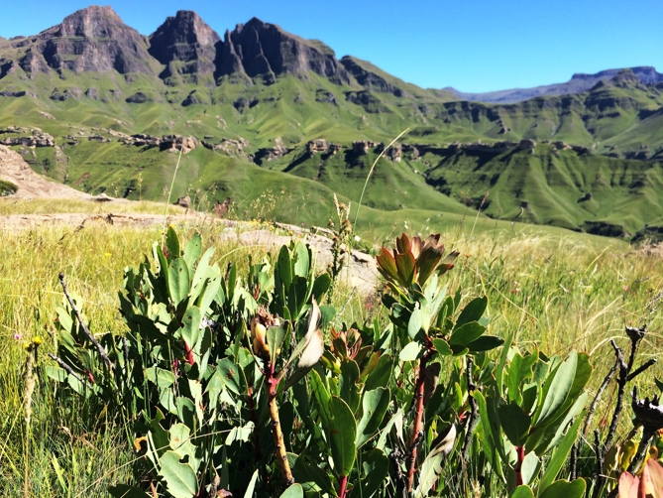
Defining the Geographic Extent
Steps in the Process
Assemble and map the information
Identify and consult stakeholders
Plan for establishment and management
Provide greater definition for agreements
Analyse, monitor and evaluate
Notes:
Photo Credit: Maloti-Drakensberg Park World Heritage Site (Lesotho and South Africa) ©Peace Parks Foundation
Defining the geographic extent
Delineating the area and mapping the detail within it involve several separate tasks.
Assemble and map the information
Clear and accurate information on the extent of the area covered by the initiative
Shows clearly what parts of each participating country will be involved
Information on how the area relates to natural and man-made features including topographical, hydrological, ecological and other information
Identify and consult stakeholders
Once target area is defined, generate a list of stakeholders involved in the area
This list should include those directly affected and those who will be influential in the establishment and management of the TBCA
Plan for establishment and management
Requires good spatial data and information for planning the establishment and management
May require rethinking scope of area in light of feasibility considerations
Provide greater definition for agreements
It is possible for agreements to be concluded in the absence of precise spatial description
But ideally an indication of the geographical area of collaboration should be indicated
Analyse, monitor and evaluate
The geographic extent of an initiative is needed to suggest methods for analysis, develop monitoring plan and evaluation framework.
A variety of technical or less technical methods may be used to delineate and map a TBCA. Selection of a method depends on resources and capacity available.
See case study of the Maloti-Drakensberg Transfrontier Project, Box 15, p. 63 of the Best Practice Guidelines.

Slide 11
Practical Exercise 2: Stakeholder Mapping
Purpose
Structure
Build capacity to define transboundary context and relationships and resulting geographic extent of TBCA
Introduction to Exercise (20 minutes)
Group Work (50 minutes)
Practice identifying stakeholders and considering their interests and how to involve them in TBCA
Joint Class Discussion (40 minutes)
Consolidation (10 minutes)
Notes:
Photo Credit: Maloti-Drakensberg Park World Heritage Site (Lesotho and South Africa) ©Maja Vasilijević
Practical exercise 2: Stakeholder mapping
Refer to Exercise 2: Stakeholder Mapping
Purpose:
Build capacity to define transboundary context and relationships and resulting geographic extent of TBCA
Practice identifying stakeholders and considering their interests and how to involve them in TBCA
Structure:
Introduction to Exercise (20 min)
Group work (50 min)
Joint Class discussion (40 min)
Consolidation (10 min)

Slide 12
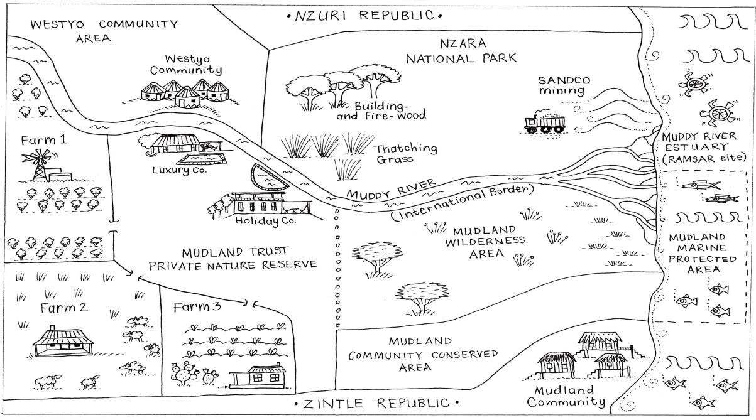
Practical Exercise 2: Stakeholder Mapping
Notes:
Photo Credit: Maloti-Drakensberg Park World Heritage Site (Lesotho and South Africa) ©Maja Vasilijević
Practical exercise 2: Stakeholder mapping
The Case Study:
Full details of the case study are provided in Exercise 2 Instructions and Annexes for participants
This slide provides a map for learners to refer to. They also have copies of the map in their groups
*Note: Instructors may choose to introduce this case study in Lesson 3, as an example for discussion of whether there is a compelling reason to act.
If this is the case, refer to Lesson 3, and less time may be needed for reading the case study
If the case study was not used in Lesson 3, this Exercise may begin with a discussion of whether there is a compelling reason to act

Slide 13
Practical Exercise 2: Stakeholder Mapping
Group Work
1. Draw proposed boundaries
2. Fill in the stakeholder matrix
What needs and threats should be considered in identifying the area?
What are the implications of inclusion of an area?
What are the implications of leaving an area out?
Who is interested in or affected by the TBCA?
How will they be affected?
How can their interests be taken into account?
3. Revisit the map and redraw boundaries as needed
Notes:
Practical exercise 2: Stakeholder mapping
This slide provides a summary of the instructions for the case study. More detail is found in Exercise 2 instructions and annexes.
Having read through the case study carefully, do the following tasks in order, in your group.
1) Draw a proposed TBCA on the map. Discuss the following questions:
What needs and threats should be considered in identifying the area?
What are the implications of inclusion of an area in a TBCA? What are the implications of leaving an area out?
2) Fill in the stakeholder matrix in Annex C. Consider the following questions:
Who is interested in or affected by the proposed TBCA?
How will these stakeholders benefit from or be negatively affected by the creation of a TBCA?
How can their interests be taken into account in development of the TBCA?
3) Look again at the map. Based on the stakeholder mapping, does your proposal change? You may redraw the boundaries if desired.

Slide 14
Transboundary Conservation Areas
End of Lesson 5
Notes:
Photo Credit: Maloti-Drakensberg Park World Heritage Site (Lesotho and South Africa) ©Maja Vasilijević

